Slide 1

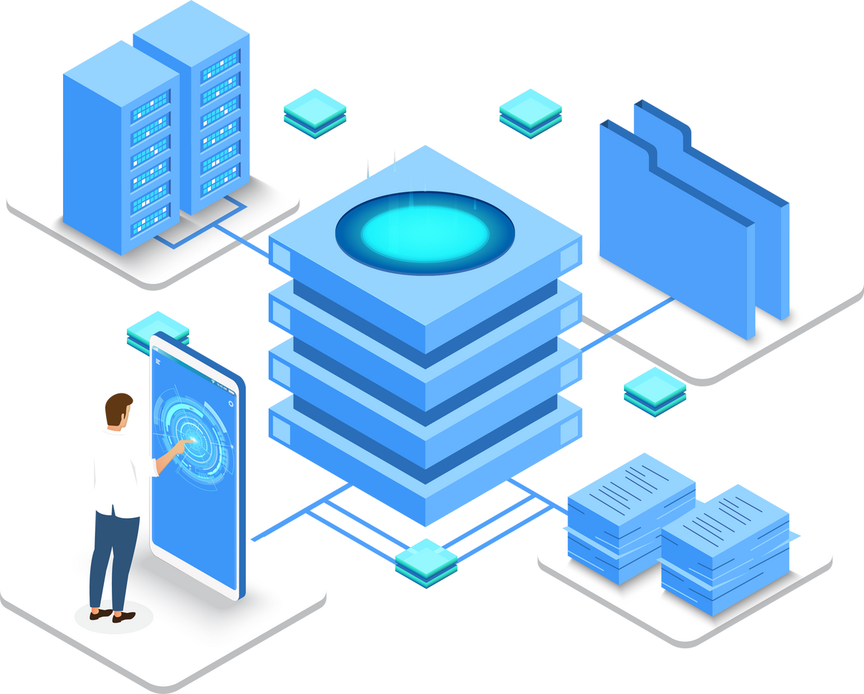
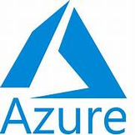
Azure Full Course

Slide 2

AGENDA
Introduction to cloud
01
Introduction to Azure
02
Azure Resources
03
Azure Full Course

Slide 3
AGENDA
Azure Virtual Machines
04
Azure Network Services
05
Azure Compute Services
06
Azure Full Course

Slide 4
AGENDA
Azure Storage Services
07
Azure IAM
08
Azure ETL tool (ADF)
09
Azure Full Course

Slide 5
AGENDA
Azure Analytics Platform
10
Azure Command Line
11
Introduction to Azure DevOps
12
Azure Full Course

Slide 6
AGENDA
Azure DevOps CI/ CD
13
Azure Kubernetes
14
Azure Monitoring Services
15
Azure Full Course

Slide 7
AGENDA
Azure Security Services
16
Azure Serverless
17
Azure PROJECT 1
18
Azure Full Course

Slide 8
AGENDA
Azure PROJECT 2
19
Azure Interviews Question
20
Azure Full Course

Slide 9
Introduction to Cloud

Slide 10
1
What is Cloud?

Slide 11
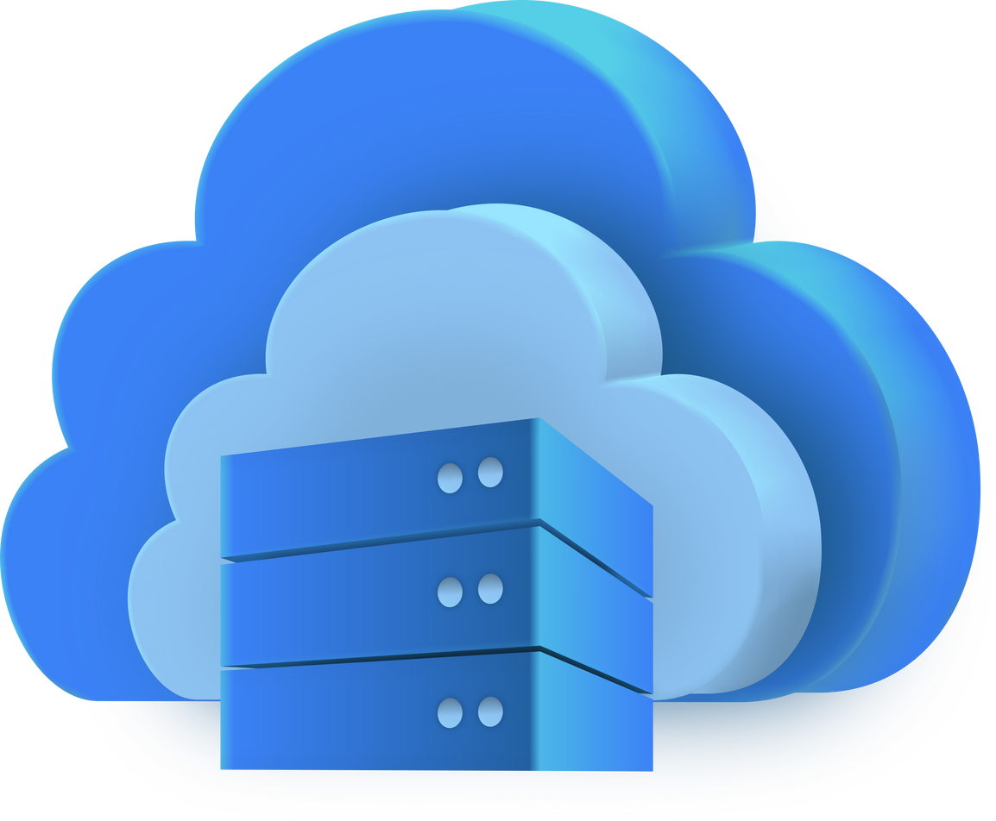
What is Cloud?

Slide 12
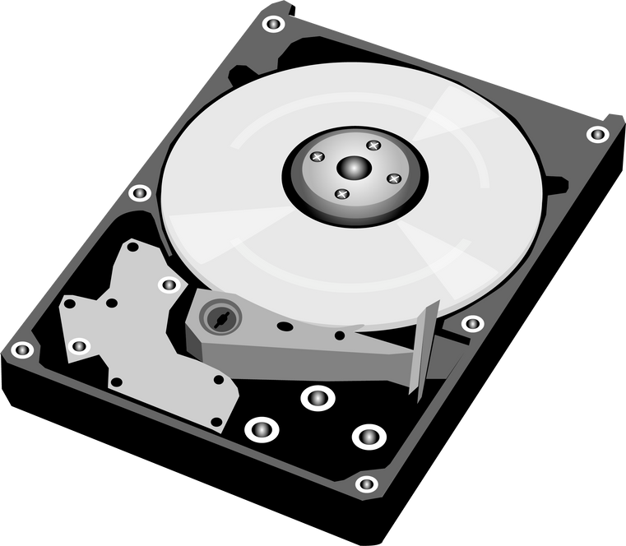
What is Cloud?
Previously we store data in harddisk
Disadvantages:
If Hard disk crashed Data will loss
Limited Capacity
We need to carry every where

Slide 13
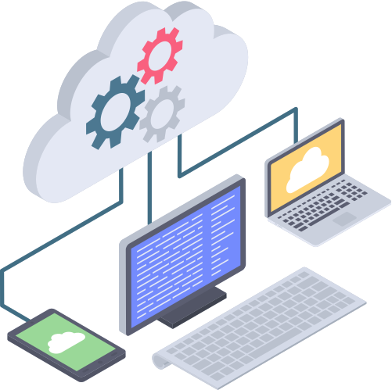
What is Cloud?
Cloud means storing and accessing data and programs over the internet instead of on your computer's hard drive.

Slide 14


What is Cloud?

Slide 15
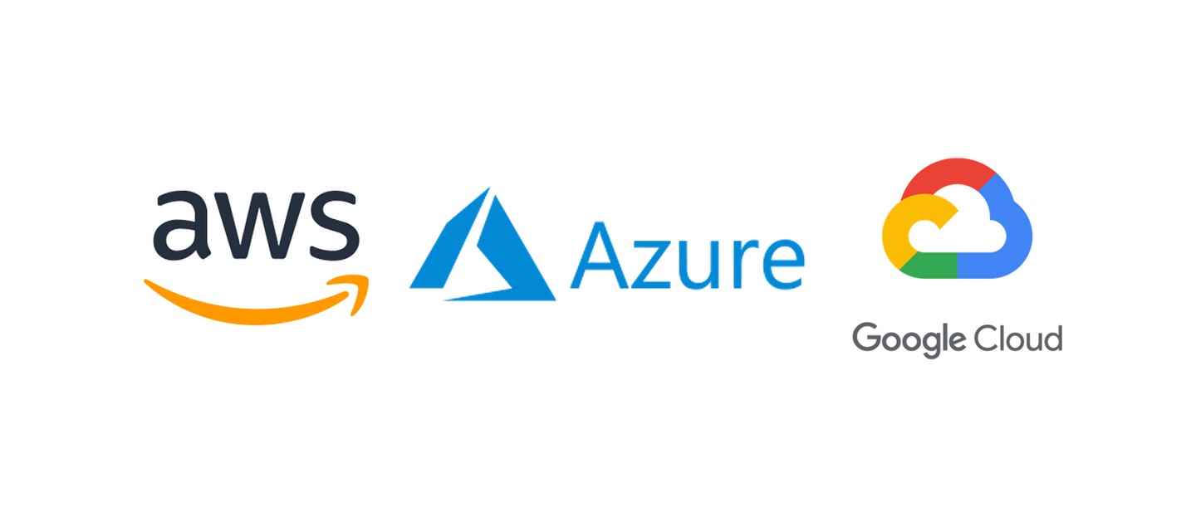
What is Cloud?

Slide 16
What is Cloud?
Cloud = Someone Else’s Computer (but with special features)
You are renting computers, storage, and services online, and you can:
Access them anytime, anywhere
Scale up or down depending on need
Pay only for what you use

Slide 17
2
What is Cloud Computing?

Slide 18
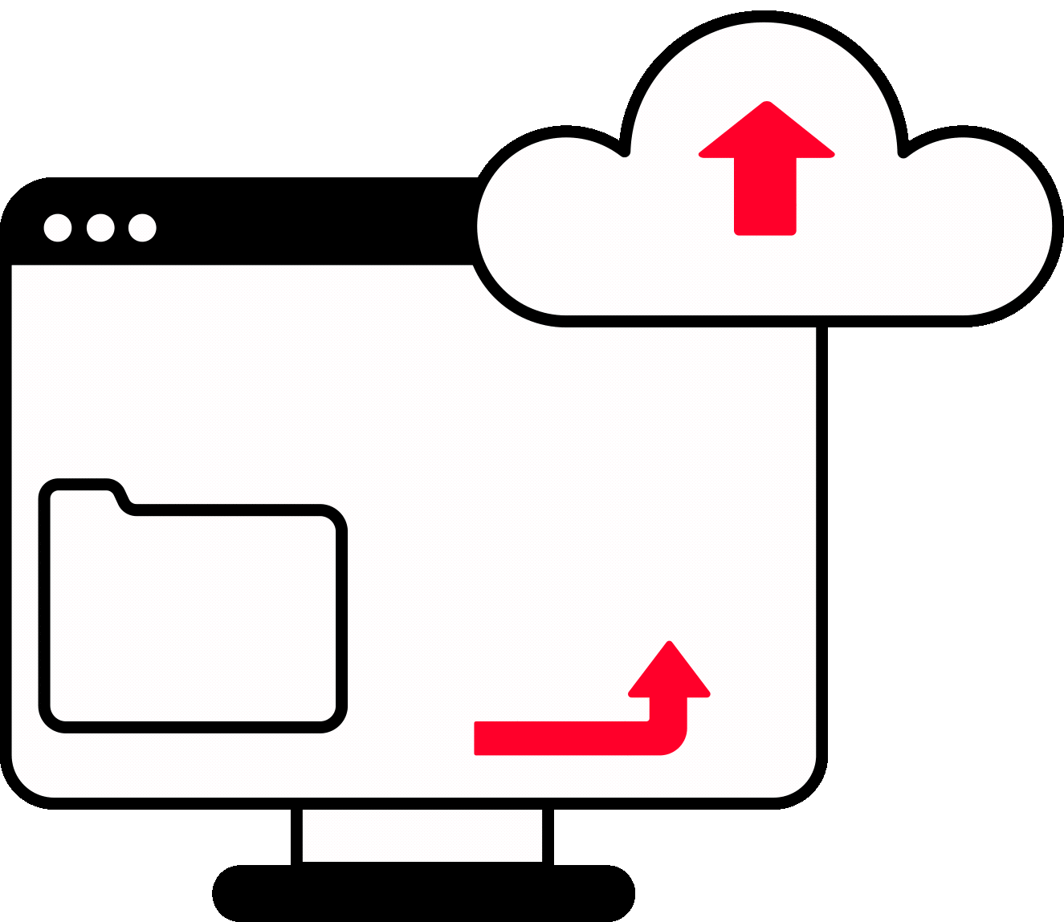
What is Cloud Computing?
Cloud computing lets you access and use IT resources (like data storage and servers) on-demand over the internet without having to buy or maintain physical hardware.

Slide 19
What is Cloud Computing?
Key Services in Cloud:
Compute – Virtual machines, containers, and serverless platforms to run applications.
Storage – Save data using object, block, or file storage.
Databases – Cloud-hosted relational (SQL) and NoSQL databases.
Networking – Connect cloud resources securely through VPCs, load balancers, etc.
AI/ML, Analytics, IoT, and more.

Slide 20
3
Types of Cloud

Slide 21
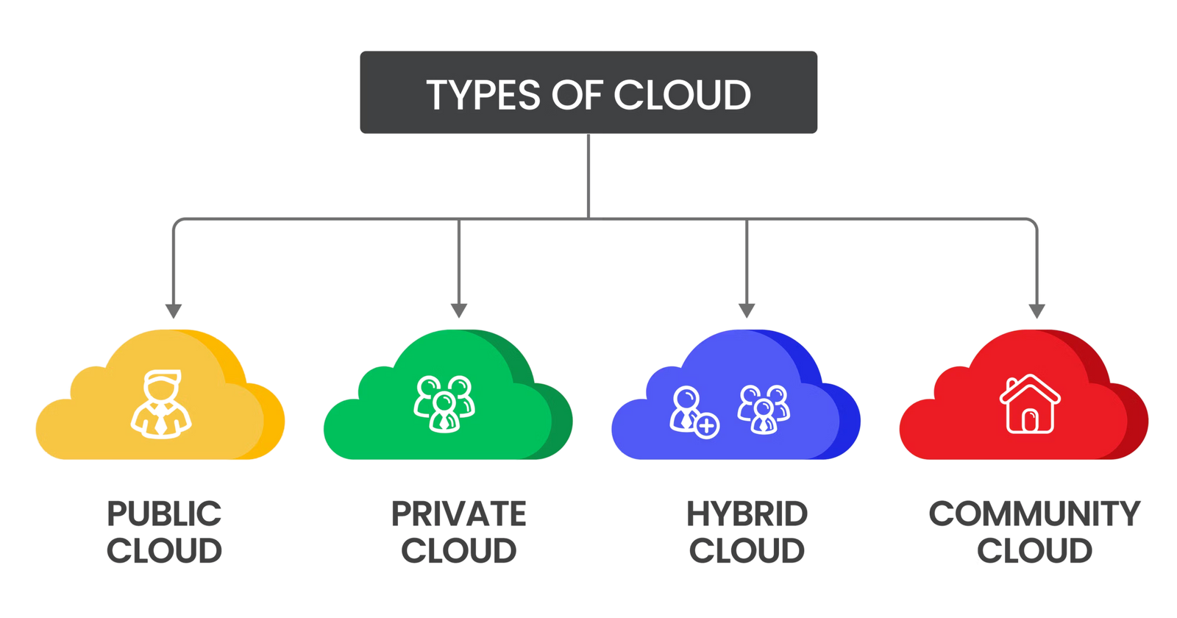
Types of Cloud

Slide 22
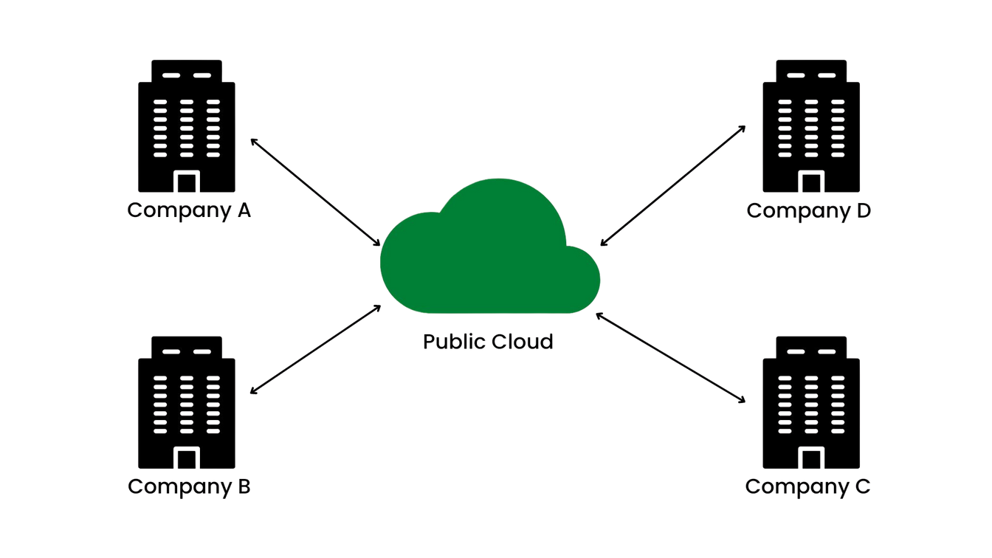
Types of Cloud
Public Cloud
Hosted by: Third-party providers (e.g., AWS, Azure, Google Cloud)
Access: Shared across multiple users (multi-tenant)
Cost: Pay-as-you-go

Slide 23
Types of Cloud
Public Cloud
Pros:
Scalable
Cost-effective
No infrastructure management
Cons:
Limited control
Potential security concerns

Slide 24

Types of Cloud
2. Private Cloud
Hosted by: A single organization (on-premises or externally)
Access: Used exclusively by one organization
Cost: Higher, due to dedicated infrastructure

Slide 25
Types of Cloud
2. Private Cloud
Pros:
Greater control and customization
Enhanced security and compliance
Cons:
Expensive to maintain and scale

Slide 26
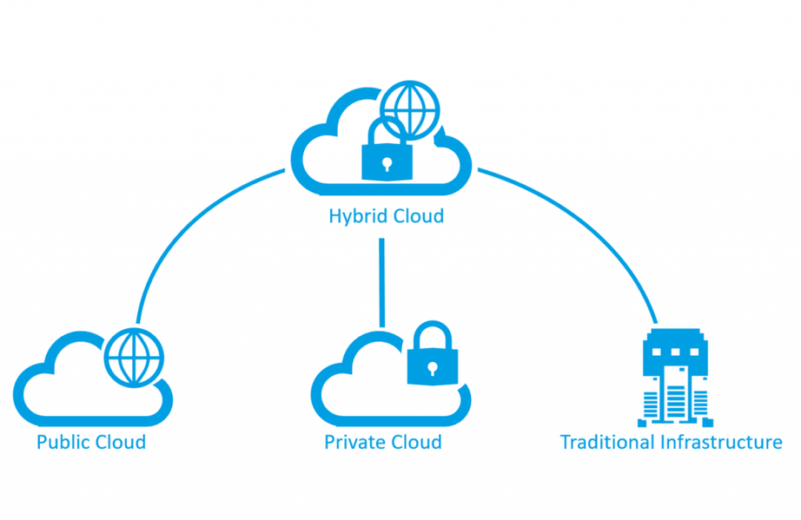
Types of Cloud
3. Hybrid Cloud
Combination: Public + Private cloud
Use Case: Workloads can move between public and private environments

Slide 27
Types of Cloud
3. Hybrid Cloud
Pros:
Flexible and scalable
Balances cost and security
Cons:
Complex integration and management

Slide 28
Types of Cloud
4. Community Cloud
Shared by: Several organizations with common concerns (e.g., regulatory, security)
Managed by: One or more parties, internally or externally

Slide 29
Types of Cloud
4. Community Cloud
Pros:
Cost shared among users
Customizable for specific community needs
Cons:
Less common
May have governance issues

Slide 30
4
Cloud Service Models

Slide 31
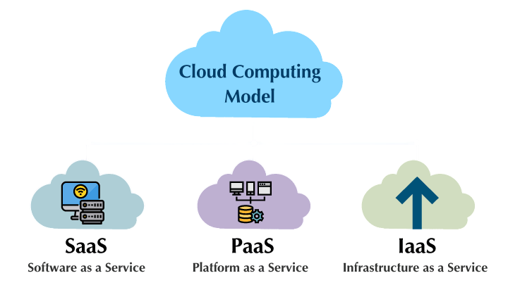
Cloud Service Models

Slide 32
Cloud Service Models
IaaS (Infrastructure as a Service)
You manage: Apps, data, runtime, middleware
Provider manages: Virtual machines, servers, storage, networking
Use Case: You want to control the OS and runtime but avoid hardware costs.
Examples:
Amazon EC2
Microsoft Azure Virtual Machines
Google Compute Engine

Slide 33
Cloud Service Models
2. PaaS (Platform as a Service)
You manage: Just the application and data
Provider manages: OS, middleware, runtime, servers
Use Case: Developers focus on writing code without managing infrastructure.
Examples:
Google App Engine
Heroku
Microsoft Azure App Services

Slide 34
Cloud Service Models
3. SaaS (Software as a Service)
You use: The software via the web
Provider manages: Everything (app, data, infra)
Use Case: End users who want to access applications without installation.
Examples:
Gmail
Microsoft 365
Salesforce
Zoom

Slide 35
5
On Premises vs Cloud

Slide 36
On Premises vs Cloud
What is On-Premises (On-Prem) in Cloud Computing?
On-premises refers to a computing environment where all hardware, software, and data are hosted and managed locally at an organization's own facilities — rather than in the cloud.

Slide 37
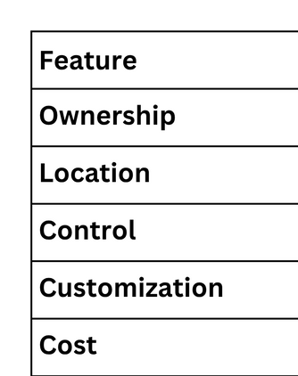
On Premises vs Cloud
Features of On Premises

Slide 38
On Premises vs Cloud
Common Use Cases:
Financial institutions needing strict data control
Government agencies with classified information
Legacy systems that are not cloud-ready
Enterprises with massive IT infrastructure already in place

Slide 39
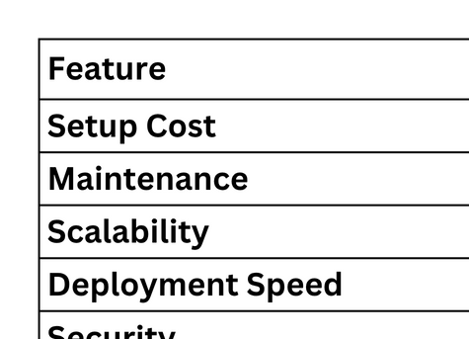
On Premises vs Cloud
On Premises vs Cloud

Slide 40
6
Basic Cloud Terms

Slide 41
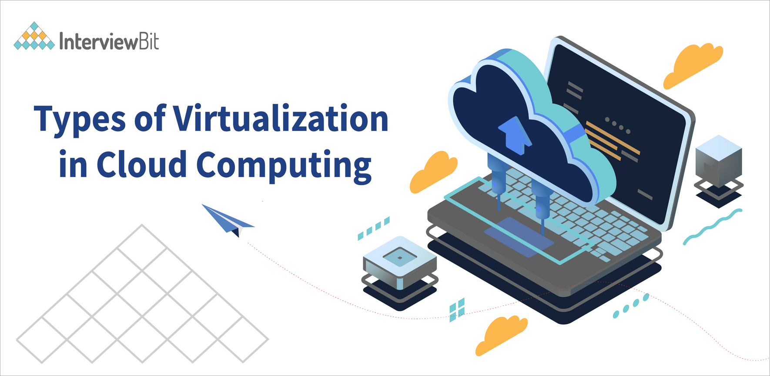
Basic Cloud Terms
Virtualization
Virtualization is the process of creating a virtual (rather than physical) version of computing resources such as hardware platforms, storage devices, network resources, or operating systems. It allows multiple virtual systems to run on a single physical system, improving efficiency, flexibility, and scalability.

Slide 42
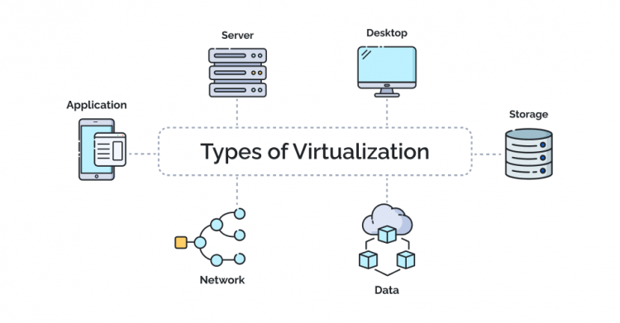
Basic Cloud Terms
Types of Virtualization

Slide 43
Basic Cloud Terms
Virtual Machine
A Virtual Machine (VM) is a software-based simulation of a physical computer. It runs an operating system and applications just like a physical computer, but it does so in an isolated environment created by virtualization software called a hypervisor.

Slide 44
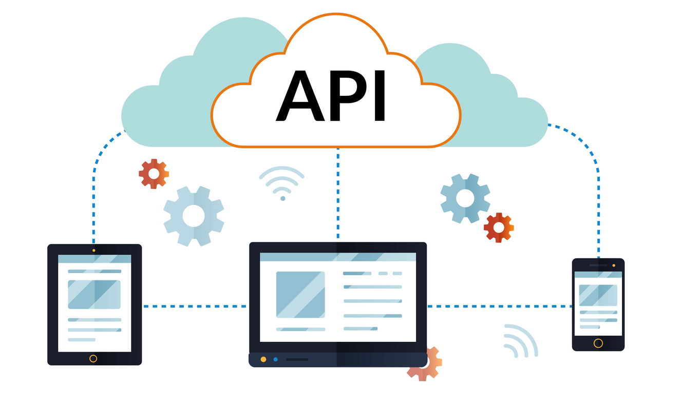
Basic Cloud Terms
Application Programming Interface
API (Application Programming Interface) is a set of rules and protocols that allows different software applications to communicate with each other. It defines the methods and data formats that applications can use to request and exchange information.

Slide 45
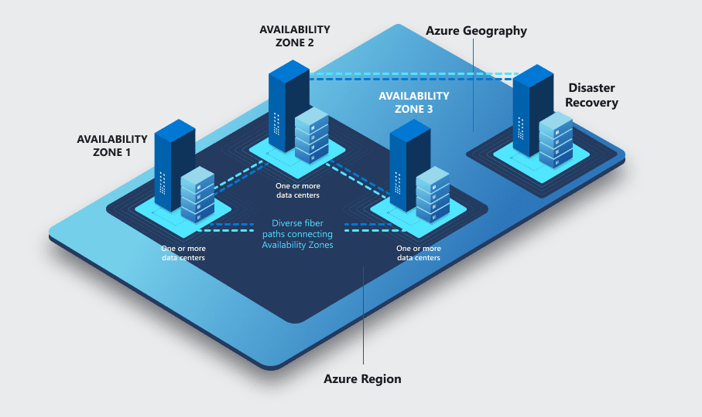
Basic Cloud Terms
Region
A cloud region is a geographically distinct location where cloud service providers house their data centers.
Each region typically consists of multiple Availability Zones (AZs) — isolated data centers within that region — to ensure high availability, fault tolerance, and disaster recovery.

Slide 46
Basic Cloud Terms
Availability Zones
Availability Zones are isolated locations within a region that have their own power, cooling, and networking. They are designed to provide high availability and fault tolerance.

Slide 47
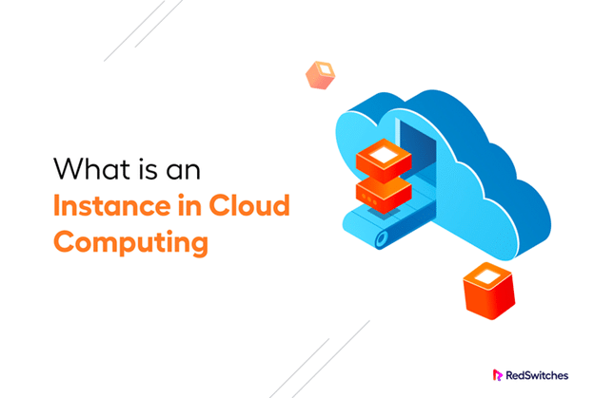
Basic Cloud Terms
Instance
An instance is a virtual version of a computer (CPU, memory, storage) running in the cloud — similar to a physical server, but hosted virtually.

Slide 48
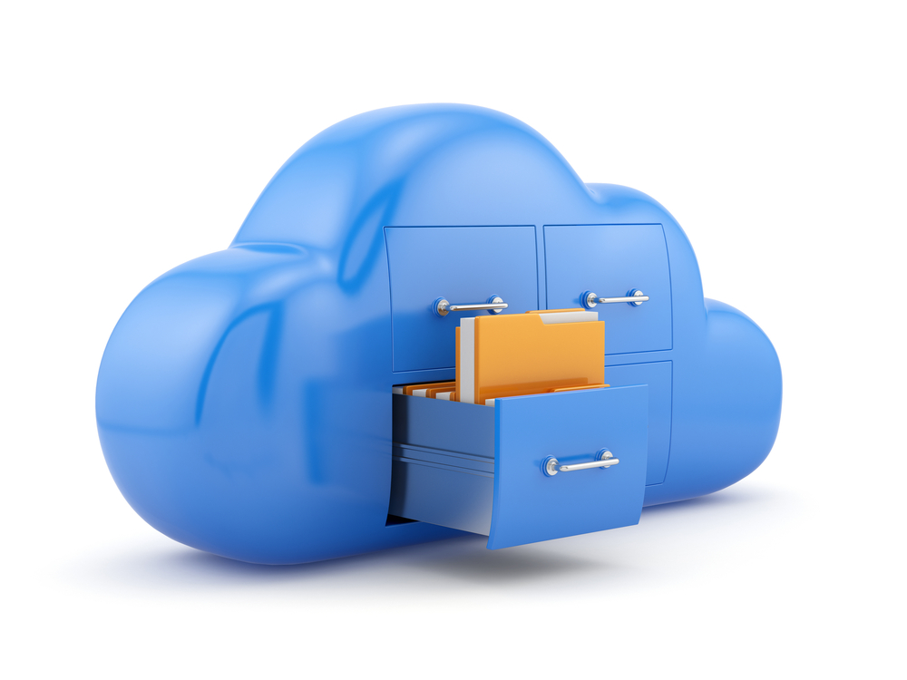
Basic Cloud Terms
Container
A container is like a sealed lunchbox: it contains everything the application needs to run, regardless of where it’s opened — your laptop, a server, or the cloud.

Slide 49
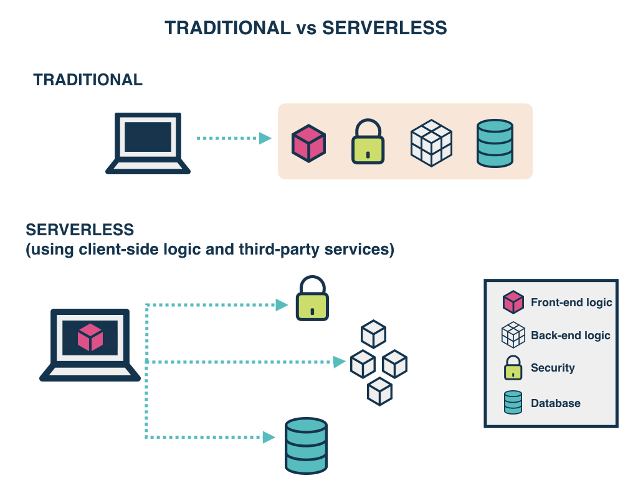
Basic Cloud Terms
Serverless
"Run code without managing servers."
With serverless, you write and deploy code, and the cloud provider automatically:
Allocates resources
Runs your code
Scales based on demand
Shuts down when done

Slide 50
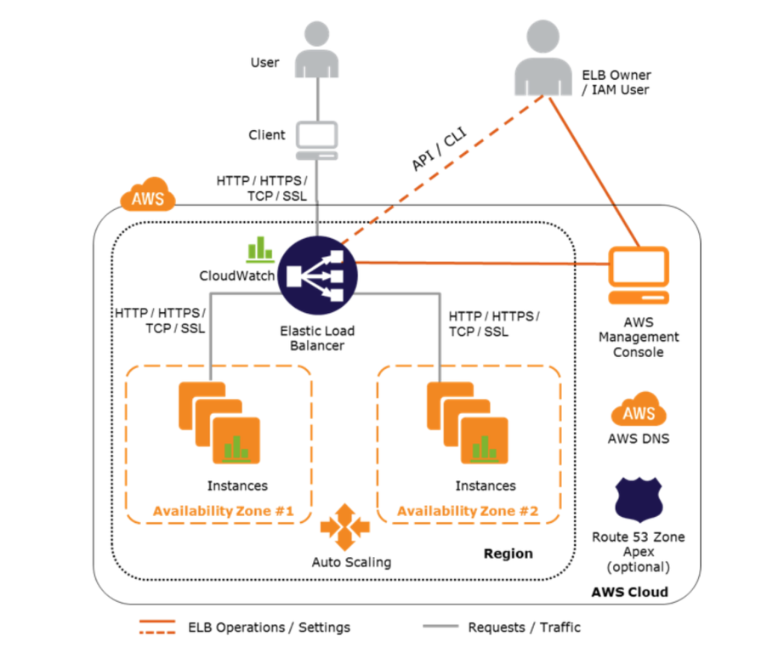
Basic Cloud Terms
Auto Scaling
"Automatically add or remove servers based on the load."
Your application can increase capacity when demand spikes and reduce it when demand drops.
Instead of running a fixed number of servers 24/7, auto scaling lets the cloud add or remove them dynamically.

Slide 51
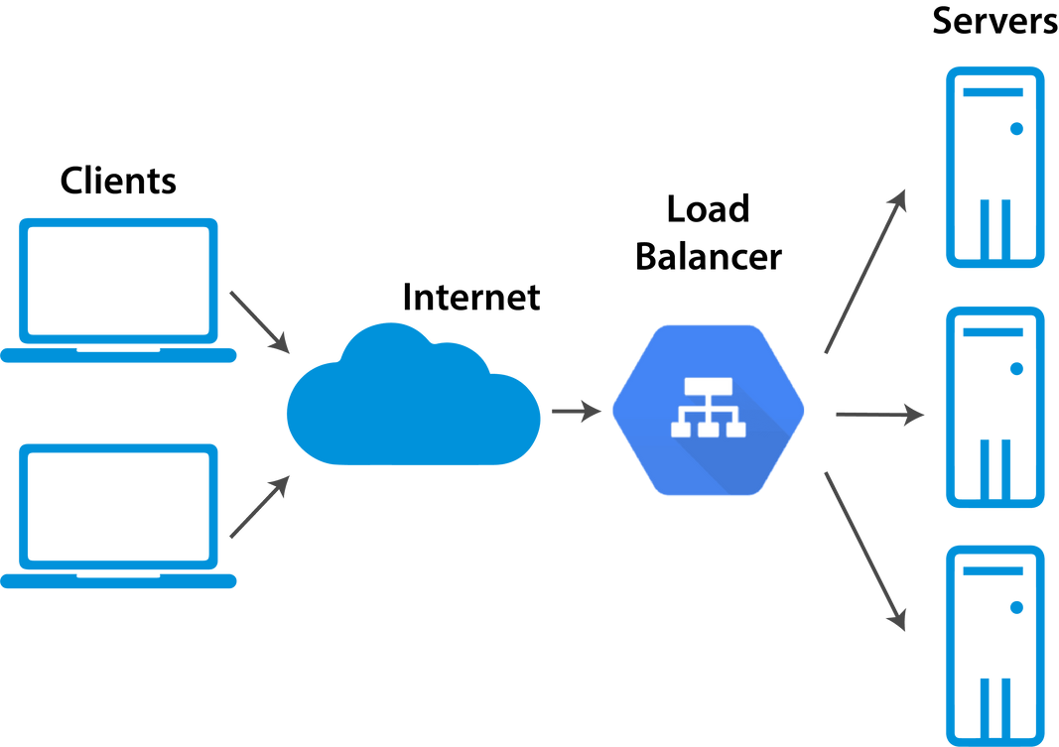
Basic Cloud Terms
Load Balancer
"Distribute traffic across multiple servers to keep things running smoothly."
A Load Balancer sits in front of your application servers and spreads incoming requests so no single server is overwhelmed.
It can also detect unhealthy servers and stop sending traffic to them.

Slide 52
THANK YOU

